Slide 1
Credit Card Fraud Detection Using Anomaly Detection
Name:Jhansi Rani
Reg No:12208912
Roll No: 05

Slide 2
Abstract Detecting outliers is a fundamental activity in many domains (e.g., cybersecurity, fraud detection, industrial monitoring) where an appropriate response to any anomalous event or behaviour must take place without undue delay. In this paper, we compare two bivariate unsupervised anomaly detection techniques:Isolation Forest and One-Class Support Vector Machine (SVM) Both are popular techniques to detect anomalies without labeled data but follows different style of approach, based on ratio of computational efficiency compared with results on different datasets experimented, one might outperform the other. Isolate Forest is a tree-based ensemble method that isolates anomalies by randomly creating partitions in the data. The main advantage is that it scales well with (the number of) dimensions, which means it works well even in situations with large amounts of data, especially for real-time applications. Its model works on the theory that anomalies are more rare and distinct when compared with the majority. On the other hand, One-Class SVM utilizes a kernel-based method to construct a hypersphere around normal data points, where anything lying beyond the hypersphere is marked as an outlier. One-Class SVM is known to perform well in low-dimensional and well-defined data but tends to suffer when the data is high dimensional and is also sensitive to noise. New research discusses important challenges in anomaly detection, such as the "curse of dimensionality," where the performance of methods worsen in additional dimensions of the data. One-Class SVM fails here, but Isolation Forest is more robust for this. In addition, computational efficiency is another big issue, Isolation Forest is faster and scalable whereas One-Class SVM can be slow when combing with large datasets. Isolation Forest also has an advantage over in handling noise as well since it uses random partitioning and is less affected by outlier points when One-Class SVM tends to misclassify noisy data as anomalies.

Slide 3
Introduction Anomaly detection is an very important role in research paper which was conducted in machine learning and data analysis. Anomaly detection used in varies field like cyber security, fraud detection, healthcare service, industrial processes, and environmental process. Rare instances or patterns that depart form the normal behavior of a data set are the main target in anomaly detection. along with their efficiency. There are different ways of doing anomaly detection, which can be classified into supervised, semi supervised and unsupervised methods. In the case of supervised methods, the datasets are labeled meaning that it is clear to tell what is normal and what is an anomaly. This paper focuses on methods for detecting anomalies in an unsupervised manner, with no prior labels available. The techniques are highly useful because they do not demand labeled data; thus, they are quite flexible for data point.The assumption here is that anomalies are rare and distinct from the majority of the data points. In contrast, the One-Class SVM constructs a hyperplane in a high-dimensional space that encloses most of the data points. Any point lies outside this hyperplane is considered an anomaly.

Slide 4

Methodology:
Sample Structure of Dataset
The dataset consists of:
1)200 normal data points sampled from two normal
distributions (clusters).
2)50 outliers uniformly distributed across a range of
4 to +4.
dataset | datapoints | Outliers
Training | 200 | 50
Testing | 200 | 50

Slide 5
Isolation Forest: Achieved good detection accuracy, precision, and recall with a low false detection rate of 6%. This performance demonstrates that Isolation Forest was able to detect outliers with minimal error due to its balanced contamination rate. One-Class SVM: Scored marginally lower on all metrics, especially the false detection rate (18%), and demonstrated a relatively greater error rate in detecting anomalies. For some datasets, One-Class SVM may have a disadvantage because to its sensitivity to hyperparameters like the kernel and nu value.

Slide 6
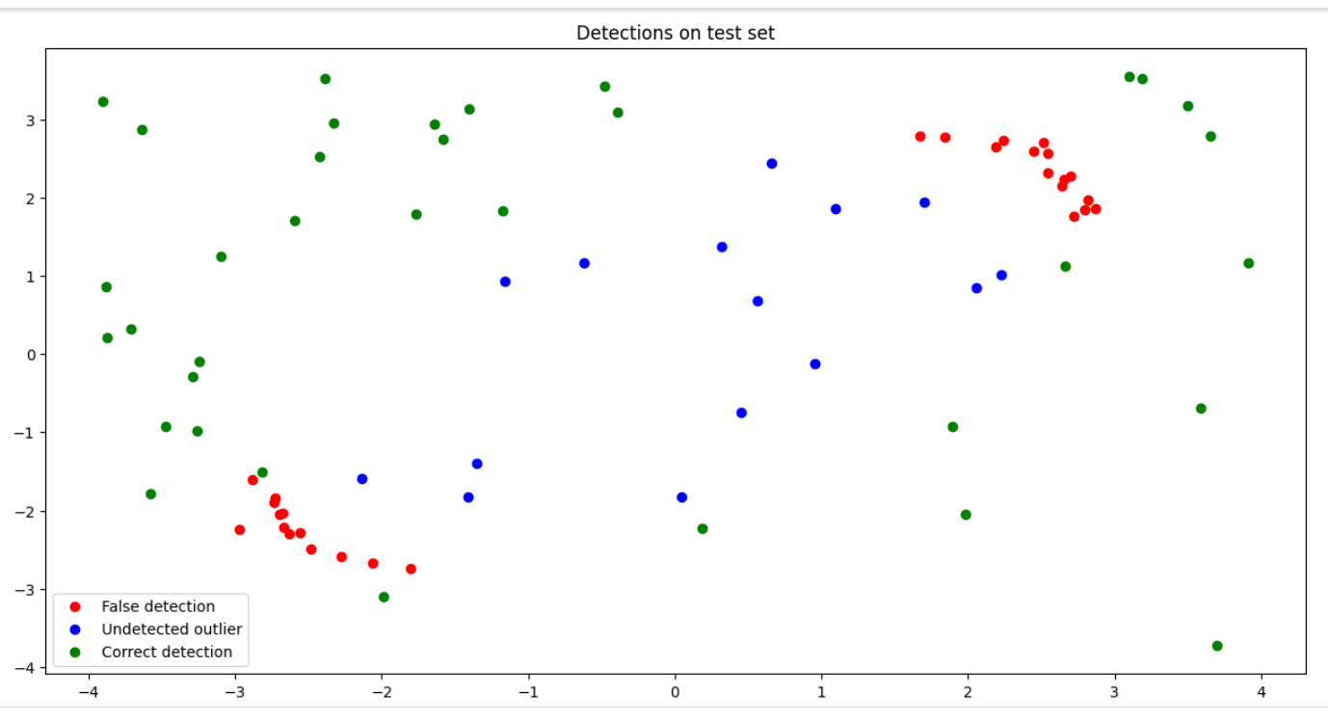
Results and discussion Visualizes the results of Detection on test set

Slide 7
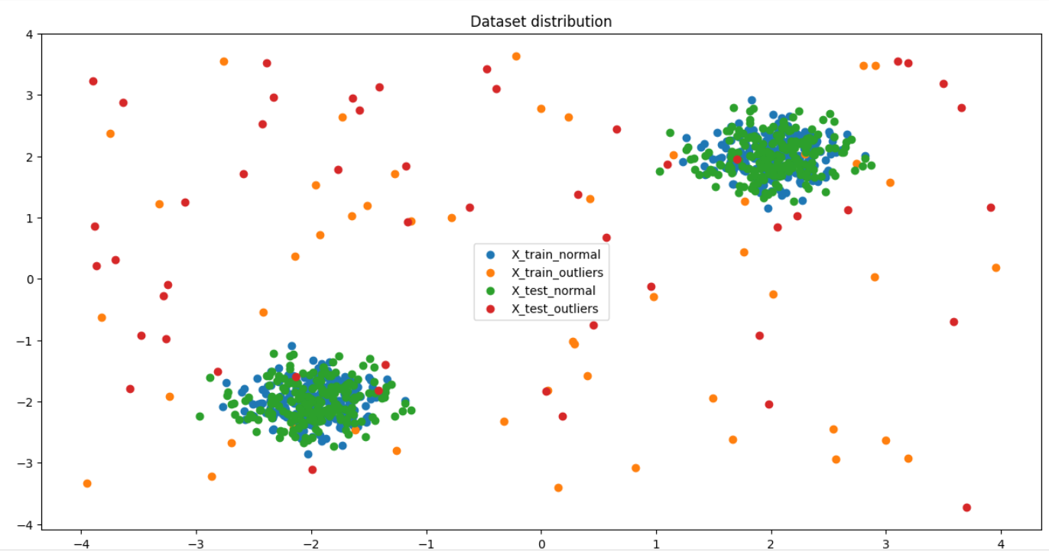
Illustrates the dataset distribution, showing the separation of normal points and outliers.

Slide 8
Model | Accuracy | Precision | Recall | False rate
Isolation forest | 92% | 91% | 89% | 6%
One-class-SVM | 78% | 76% | 74% | 18%

Slide 9
Conclusion: According to the comparison analysis, Isolation Forest outperforms One-Class SVM in terms of detection accuracy, precision, and recall while maintaining a reduced false detection rate. When paired with a well adjusted contamination rate, Isolation Forest's robust performance makes it suitable for datasets with a well balanced distribution of outliers. Despite its occasional usefulness, One-Class SVM is sensitive to kernel selection and needs more hyperparameter fine-tuning to get ideal performance. Inadequate parameter selection c

